Slide 1
Towards using machine learning to detect dialogic instruction
Andrew Olney
University of Memphis

Slide 2
Classroom Discourse
Notes:
What classroom discourse best supports learning?
open discussions prompted by open-ended teacher questions ("authentic teacher questions") in reading and literature instruction.
Specifically, previous research by Nystrand and colleagues has focused on
Questions (Teacher and Student), their Authenticity and Uptake

Slide 3
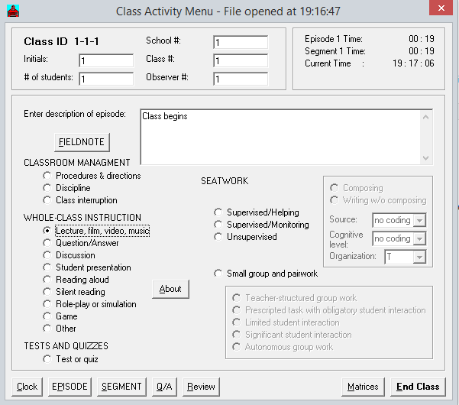
Human Measurement
Notes:
which have previously been studied by using trained observers to live-code classroom instruction.

Slide 4
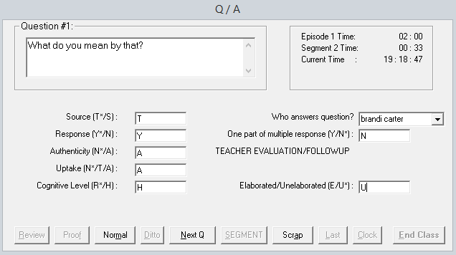
Human Measurement
Notes:
which have previously been studied by using trained observers to live-code classroom instruction.

Slide 5
Project Goal
Replace trained human coders with artificial intelligence
Automatic Speech Recognition
Natural Language Understanding

Slide 6
Methodology
Collect new measurements with advanced sensors
Microphones and Kinects
Build models using archival data
Machine learning using human codes

Slide 7
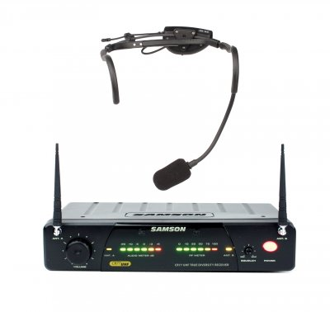
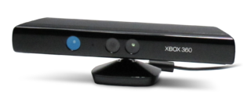
New Measurements
~400 minutes of audio

Slide 8
Speech Recognition
Assessed systems
Microsoft Speech
Google Speech
Sphinx 4:WSJ
Sphinx 4:HUB4

Slide 9
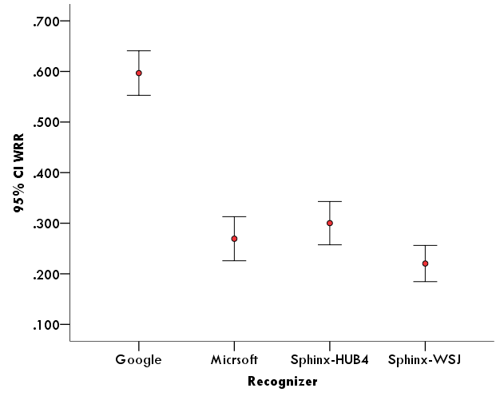
Speech Recognition: Overall
Notes:
This is 1-WER so higher numbers are better, values are b/w 0 and 1
This is overall accuracy on all teacher utterances

Slide 10
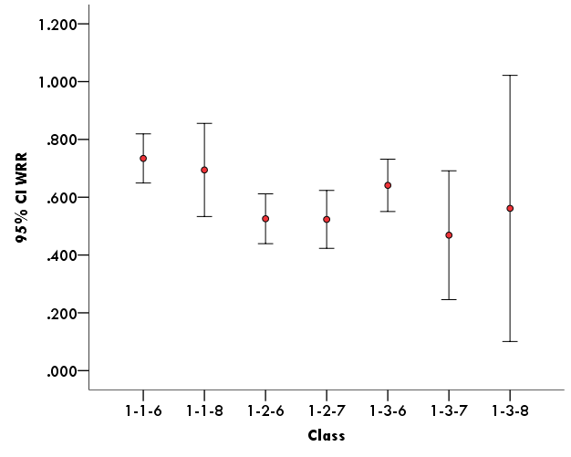
Speech Recognition: By Class
Notes:
This is teacher accuracy by class
1-3-8 only had 4 observations

Slide 11
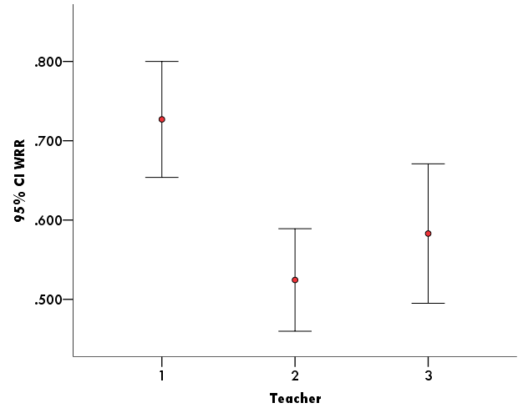
Speech Recognition: By Teacher
Notes:
This is by teacher

Slide 12
Kinects
Microphone array
Difference in time reception = angle

Slide 13
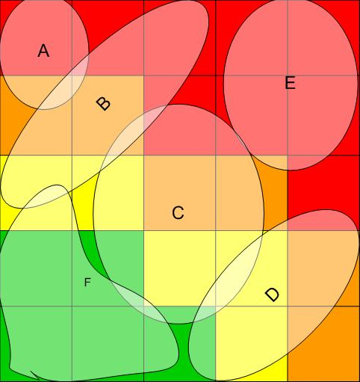
Heatmaps

Slide 14
Models using Archival Data
Question-level codes
Text
Speaker
Part of multiple response
Cognitive Level
Authenticity
Uptake
Machine learning
Observed Question Properties → Hidden Question Properties
Notes:
Nystrand et al., 2003. & Nystrand, 1997. observed discourse practices in 8th and 9th grade classrooms over two years.

Slide 15
Models using Archival Data
Isolated question vs. Question event
Is it possible to recover these variables from the isolated question?
Notes:
We attempt to predict the question event features of uptake and authenticity from the isolated question itself using machine learning techniques

Slide 16
Models using Archival Data
Notes:
In other words, what the human coders work with is this

Slide 17
Models using Archival Data
Text | Who can tell me the important word that you have to put down on the word list for Amelia J. Bloomer.
Speaker | Teacher
Part of multiple | No
Cognitive level | Recitation
Authentic | No
Uptake | No
Notes:
But what we’re working with is this

Slide 18
Authenticity: Hidden
Open ended questions
Leads to open-ended discussion
“What was your reaction to the end of the story?”
Notes:
Authenticity is defined as the question for which the asker does not have a pre-scripted answer, i.e. open-ended questions.
For example, “What was your reaction to the end of the story?” is an authentic question which leads to open-ended discussion, whereas questions such as “What was the father's name?” are not authentic.

Slide 19
Uptake: Hidden
Question about something that another person has said previously
Emphasizes the importance of students’ contribution
“Why did you say that?”
Notes:
Uptake in the context of dialogic instruction occurs when one asks a question about something that another person has said previously.
Uptake of student ideas by the teacher therefore emphasizes the importance of students’ contribution. In previous work, these indicators were judged considering the question as an event as opposed to just the individual question.

Slide 20
Question: Observed
Olney, et al. 2003
Based on part of speech, keywords, etc.
16 question categories (Graesser & Person, 1994; Graesser, Person, & Huber, 1992)
Rule Based System
Different kinds of questions might lead to different levels of uptake and authenticity

Slide 21
Methodology
Using machine learning
Predict Authenticity from question text
Predict Uptake from question text
Compare these models with
Original human codes (coding in context)
New human codes (coding in isolation)

Slide 22
Archival Data: In Context
Partnership for Literacy Study (Partnership)
7th and 8th grade English and language arts
120 classrooms in 23 schools (observed twice)
29,673 instances (25,711 utilized)
Raters agreed on question properties approximately 80% of the time
Notes:
The present study relies on the Partnership for Literacy Study data (Partnership), a study of professional development, instruction, and literacy outcomes in middle school English and language arts classrooms. The Partnership collected data from 7th and 8th grade English and language arts teachers in Wisconsin and New York State from 2001 to 2003. Over that two-year period, 120 classrooms in 23 schools were observed twice in the fall and twice in the spring.
Observational data from Partnership classrooms were coded using CLASS 4.24, a near-real-time, computer based data collection system.

Slide 23
New Ratings: In Isolation
Four human raters
Uniform sampling (100 questions per code)
Randomly ordered isolated questions
Notes:
As a baseline for evaluation of our models, we asked four human raters who were experts in education with background in classroom discourse to code the utterances of separate sample instances selected from the gold standard data.
The sample sets contained 100 questions exhibiting each category of question property and a separate 100 not exhibiting that property. For example, the uptake set contained 100 questions originally rated as non-uptake, and 100 as authentic-uptake. Similarly, the authenticity sample contained 100 questions coded as authentic along with another 100 coded as non-authentic questions.

Slide 24
Machine Learning: Features
Binary: does word appear in the question?
Casual consequent words: results, effects, etc.
Procedural, Feature specification, Negation, Meta-communication, Metacognition, Comparison, Goal orientation, Judgmental Definition, Enablement, Interpretation, Example, Quantification, Casual antecedent, Disjunction

Slide 25
Machine Learning: Features
Positional: does word appear in
Beginning, Middle, End?
Part of speech tags: Determiner, Noun, Pronoun, Adjective, Adverb, and Verb
Question stems: Do/Have, Be, Modal, What, How, Why

Slide 26
Machine Learning
Training data: subsets extracted from Gold Standard
Authenticity
25,464 instances
50-50 distribution of Authentic and non-Authentic
Uptake
9,579 instances
50-50 distribution of Uptake and no-Uptake
Notes:
Uptake originally was defined by three values: test, authentic and no uptake; however we reduced the uptake to a binary scale of authentic and no uptake. Basically the original test uptake values were taken as no uptake in the new scale

Slide 27
Machine Learning: Model
J48 Decision Tree in WEKA (Witten, et al., 2011)
Evenly balanced classes
Separate models for Authenticity and Uptake
Both using features described

Slide 28
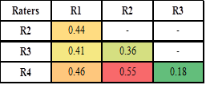
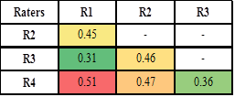
Results: In Isolation
Inter-rater reliability (kappa)
Authenticity
Uptake
Notes:
Kappa values appear low in binary scale having two equiprobable classes … these numbers show about %65-%85 agreement among raters

Slide 29
Results: In Isolation vs. In Context
Authenticity
- | Kappa | Recognition Rate
R1 | 0.13 | 56%
R2 | 0.17 | 58%
R3 | 0.25 | 62%
R4 | 0.10 | 55%
Model | 0.34 | 67%
Notes:
Models trained in isolation against codes created in full context, only 100 per class

Slide 30
Results: In Isolation vs. In Context
Uptake
 | Kappa | Recognition rate
R1 | 0.22 | 61%
R2 | 0.25 | 62%
R3 | 0.30 | 65%
R4 | 0.23 | 61%
Model | 0.46 | 73%
Notes:
Models trained in isolation against codes created in full context, only 100 per class

Slide 31
Results: In Isolation, All Data
10 fold cross validation
Models | Kappa | Accuracy
Authenticity | 0.28 | 64%
Uptake | 0.24 | 62%
Notes:
Can’t compare to humans rating in isolation here b/c they didn’t recode all the data
All the test and training sets are in uniform distribution.
The overall performance of Authenticity on the gold standard data was close to performance on the sample data while the uptake model performed with a lower accuracy; however the results are still close to human raters coding questions in isolation which support the reasonable performance of our models on this task.

Slide 32
Results: Unpacking the Model
Correlation-based Feature Subset Selection (CFS)
Authenticity Judgmental keywords, WH words, Enablement keywords, and “what”
Uptake Negation keywords, Judgmental keywords, and “why”
Notes:
we ran Correlation-based Feature Subset Selection (CFS) on our feature sets.
CFS considers the individual predictive ability of each feature along with the degree of redundancy between them to evaluate the worth of a subset of attributes.

Slide 33
Results: Unpacking the Model
Authenticity:
“Do you think enterprising people always need to be audacious?” “Did you find it helpful?” “Do you think it needed to go on the next ten lines?”
Uptake:
“Why do you think he wants to help the little boy?” “You think he can't get help, Can you expand on that?” “Like if I make a connection to my life and not to all three of them do you think that that might help?”
Notes:
we ran Correlation-based Feature Subset Selection (CFS) on our feature sets. CFS considers the individual predictive ability of each feature along with the degree of redundancy between them to evaluate the worth of a subset of attributes.

Slide 34
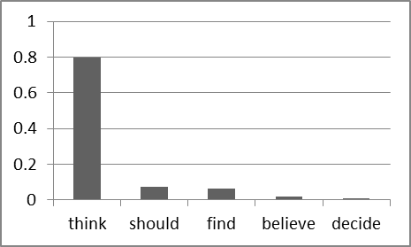
Results: Key-Keywords
Judgmental keywords
Notes:
To illustrate the actual words that were coded as these features, for each set of keywords we calculated the frequency of these words in the data set and measured the distribution of each word as a proportion of the frequency of all the words in the keyword set.

Slide 35
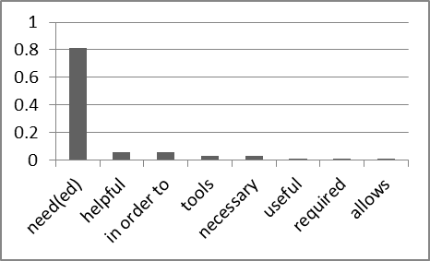
Results: Key-Keywords
Enablement keywords
Notes:
To illustrate the actual words that were coded as these features, for each set of keywords we calculated the frequency of these words in the data set and measured the distribution of each word as a proportion of the frequency of all the words in the keyword set.

Slide 36
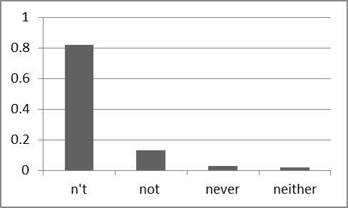
Results: Key-Keywords
Negation keywords
Notes:
To illustrate the actual words that were coded as these features, for each set of keywords we calculated the frequency of these words in the data set and measured the distribution of each word as a proportion of the frequency of all the words in the keyword set.

Slide 37
Conclusion
Models >= Human on isolated questions
But still 20% gap between isolated and full
Gap applies to model AND humans
What cues are missing? → Future work!!!

Slide 38
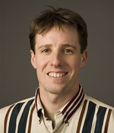
Team
University of Memphis
Andrew Olney Art Graesser Borhan Samei Sean Kelly Laura Northrop
University of Wisconsin
Martin Nystrand Marci Glaus Xiaoyi Sun Sidney D’Mello Nathan Blanchard
University of Pittsburgh
University of Notre Dame
(PI)

Slide 39
Questions?
http://www.english.wisc.edu/nystrand/class.html
http://andrewmolney.name
This research was supported by the Institute of Education Sciences (IES), U.S. Department of Education, through Grant R305A130030. Any opinions, findings and conclusions, or recommendations expressed are those of the authors and do not necessarily reflect the views of IES

Slide 40
Introduction
Bakhtin (1981, 1986), Rommetveit (1974), and Vološinov (1973/1929)
the role of interaction in learning
Alexander (2004), Dyson (2000), Nystrand (1997), Wells (1999)
highlight discourse as a reflection of teachers’ and students’ voices (classroom-based face-to-face interactions)
Notes:
This work is theoretically grounded in the dialogism of Bakhtin (1981, 1986), Rommetveit (1974), and Vološinov (1973/1929) which elaborates the role of interaction in both learning generally and reading comprehension specifically. They highlight discourse as a refraction of teachers’ and students’ voices as they dynamically figure things out in classroom-based face-to-face interactions (Alexander, 2004; Dyson, 2000; Nystrand, 1997; Wells, 1999)

Slide 41
Introduction
Open-ended discussion and the exchange of ideas are at the core of the dialogic instruction.
Increase student engagement in classroom instruction (Gamoran & Nystrand, 1992)
Notes:
when teachers focus on provoking student thought and analysis, and postpone evaluation during question and answer sessions by engaging in dialogic instruction, levels of student effort are more evenly distributed among students (Kelly, 2008, 2009).

